Slide 1
Brief History and Current Status of Buddhism in Southern Mongolia
Enghebatu Togochog
October 11, 2014

Slide 2
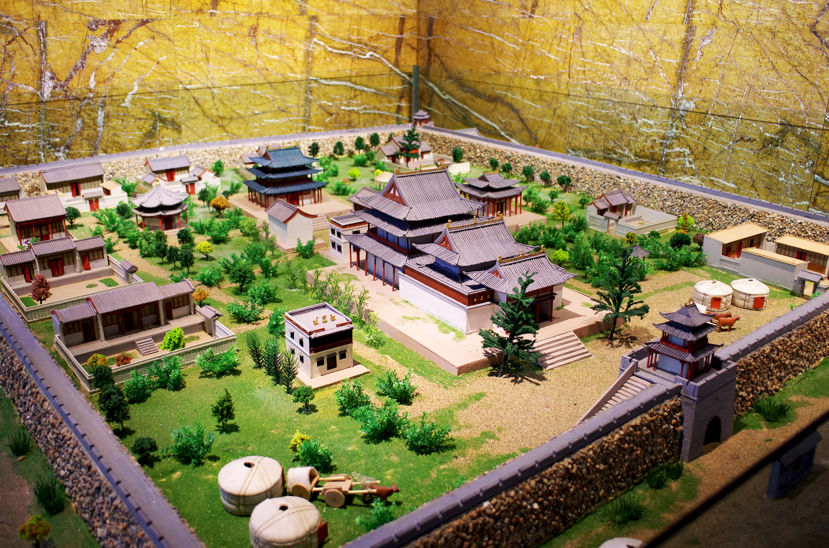
Gelug Order: Yellow-Hat
Yellow-hat started to spread in Mongolian region in mid 16th century
First Yellow-hat Buddhist monastery: Maidar Zuu

Slide 3
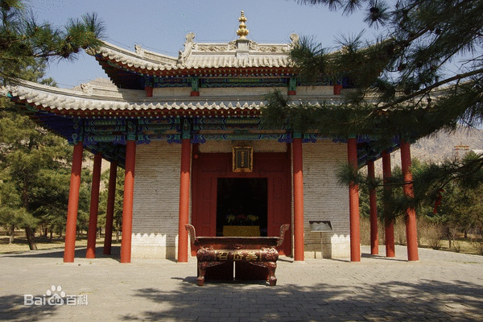
Maidar Zuu built in 1571 by Altan Khan
Modern day Tumed Right Banner
15 years earlier than Erdenzuu Monastery

Slide 4
Altan Khan met the Sonam Gyatso in 1577
Sonam Gyatso publicly announced himself as reincarnation of Phagpa
Similarly Altan Khan was recognized as reincarnation of Khublai Khan
Altan Khan gave the title of “Dalai Lama” to Sonam Gyatso
Posthumous to Gendun Drup and Gendun Gyatso as 1st and 2nd Dalai
Yellow-hat became state religion

Slide 5
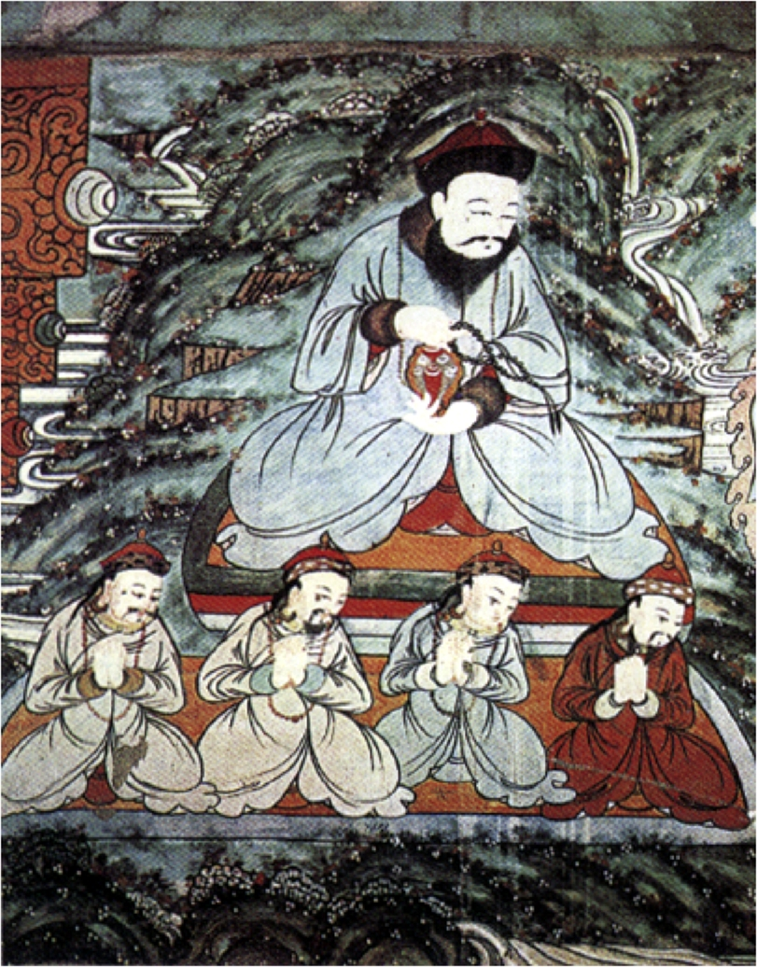
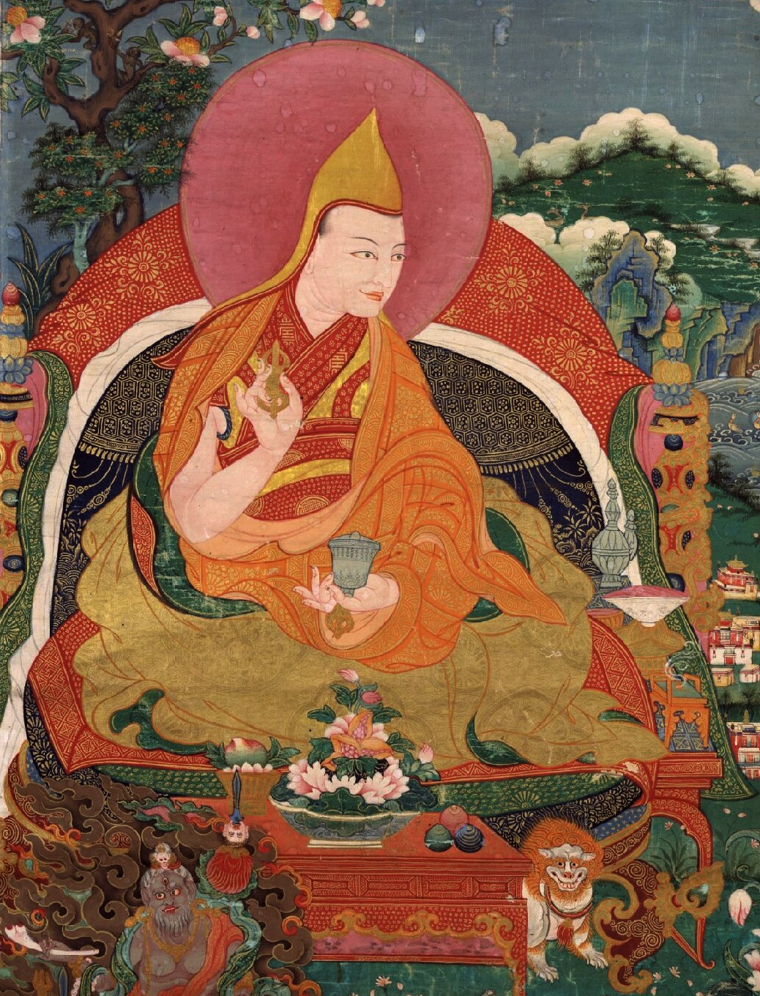

Slide 6
Altan Khan declares to turn “ocean of blood to ocean of milk” (“Dalai Lama and the King Demon”, by Raimondo Bultrini)
Turning point of Mongolian spirituality and belief
Mongolian heroism to no bloodshed transition
Shortly Altan Khan’s great grandson Yonten Gyatso became 4th Dalai Lama

Slide 7
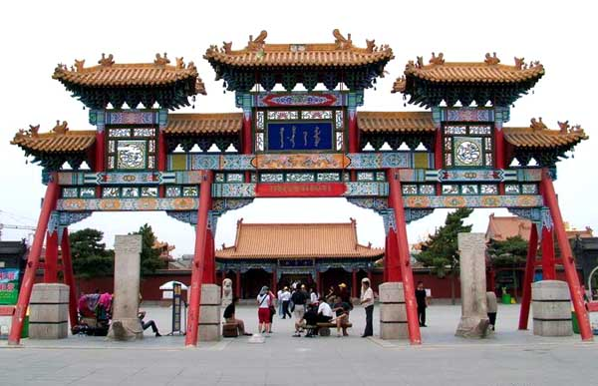
Ikh-Zuu built in 1579 by Altan Khan
Located in suburban Hohhot
Second earliest to Maidar-Zuu

Slide 8
Manchu Qing promoted Buddhism in Mongolian region
“Instead of feeding one thousand soldiers build one Buddhist monastery”
Lamas and monasteries are exempt from taxation and military draft
Mid Qing: Heyday of Buddhism in Mongolian areas

Slide 9
Mid 18th century: 1,800 monasteries and 150,000 Lamas
Mid 19th century: 1,600 monasteries and 100,000 Lamas
In 1911 census, total population of Southern Mongolia was 1,494,495 and 1,341 monasteries
20 some monasteries per Banner or Hushuu (2003, Isabelle Charleux)

Slide 10
1945: Not including 36 monasteries of Tumed and Gorlos
Leagues (Aimag) | Monasteries | Lamas
Jirim | 242 | 12,174
Zuun-uda | 201 | 9,897
Hulun-boir | 42 | 2,655
Hingaan | 31 | 2,614
Shiliin-gol | 273 | 14,378
Ulaanchav | 139 | 2,611
Ikh-zuu | 252 | 9,000
Bayannuur | 60 | 3,368
Alshaa | 37 | 4,103
Huhhot | 39 | 350
Bogot | 15 | 700
TOTAL | 1,331 | 61,850

Slide 11
1949 – 1979: Destruction
Communist China – PRC established
“Religion is opium” policy
“Lama Patriotic Agreement” in 1951
Destruction of monasteries and persecution of monks
Waves of political movements including the Cultural Revolution
Exactly how many monks killed and how many monasteries destroyed? Unknown!

Slide 12
1949 – 1978: Destruction and Persecution
Communist China – PRC established
“Religion is opium” policy
Destruction of monasteries and persecution of monks
Waves of political movements including the Cultural Revolution
Exactly how many monks killed and how many monasteries destroyed? Unknown!

Slide 13
1978 – 1990: Restoration
State financed restoration of Buddhist monasteries
Purpose of concealing destruction of Mongolian culture
Purpose of tourism and showcasing “religious freedom”
In 1984, 3,854 official registered Lamas

Slide 14
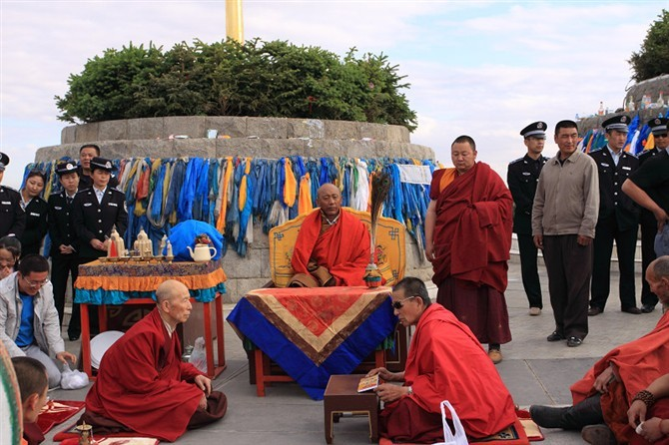
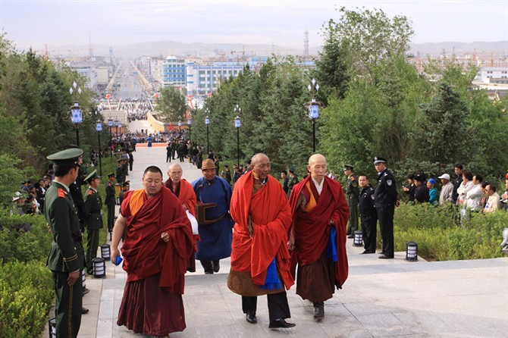
1990 – Present
Buddhist functions are monitored

Slide 15
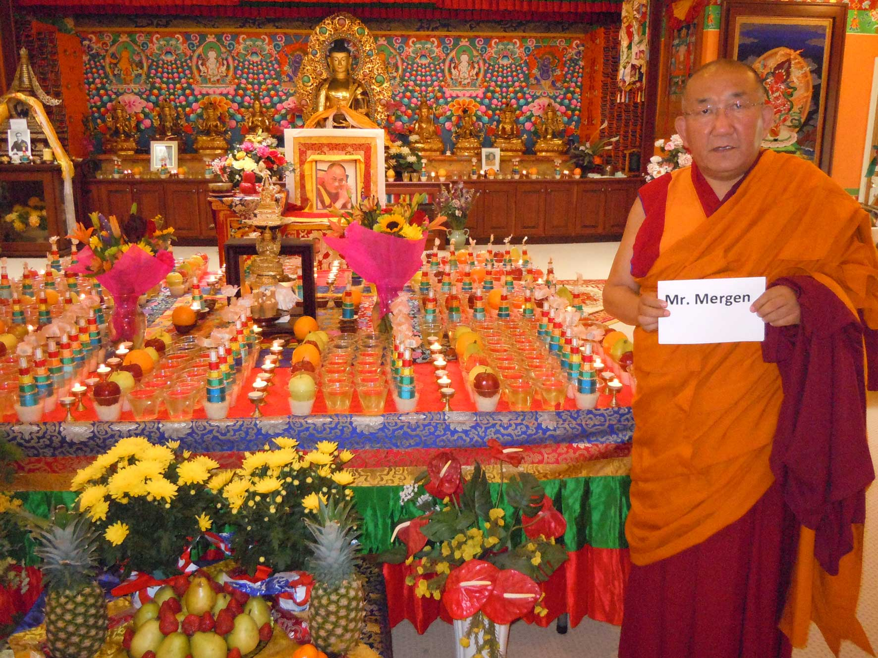
Ajaa Gegeen told: No reincarnation
No inter-province communication

Slide 16
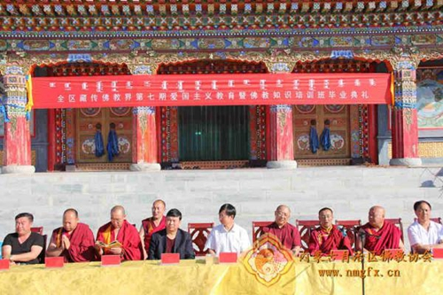
1990 – Present
“Patriotic Education” to Lamas

Slide 17
NO RELIGIOUS FREEOM
In
Southern Mongolia!

